Slide 1
Simple C Program

Slide 2
#include<stdio.h>
void main()
{
;
printf
(“Hello World..”)
}

Slide 3




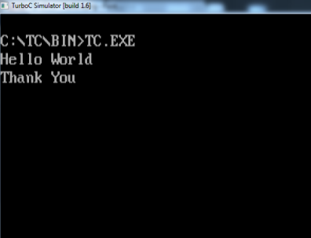
Steps of Program Execution
Compiler
C Program
Machine Code
010100011010
101011100000
101010101010
001110101010
Output

Slide 4
#include<stdio.h>
void main()
{
printf(“Hello World..”);
}

Slide 5
Output:
#include<stdio.h>
void main()
{
printf(“Hello World..”);
}
Hello World..

Slide 6
Output:
#include<stdio.h>
void main()
{
printf(“Hello World..”);
printf(“How are you?”);
}
Hello World..How are you?

Slide 7
Output:
#include<stdio.h>
void main()
{
printf(“Hello World..”);
printf(“
}
How are you?”);

Slide 8
Output:
#include<stdio.h>
void main()
{
printf(“Hello World..”);
printf(“\nHow are you?”);
}
Hello World..
How are you?

Slide 9
That’s all

